Slide 1


Department of Computer Science and Engineering
VR SIDDHARTHA ENGINEERING COLLEGE, VIJAYAWADA
DefectVision AI: Multi-Model Industrial Defect Detection and Intelligent Quality Inspection System
23AI&ML7552: B. Tech Mini Project (1st Review)
18th August 2026 Batch No: 26
Batch Members
P. Venkata Naveen – 248W5A4204
P. Surya Charan – 238W1A4251 Ch. Jaswanth – 238W1A4206
Under the Guidance of
Mr. S. Rajesh Assistant Professor
1

Slide 2
Abstract
Industrial quality inspection is a critical process in manufacturing, where
manual inspection is often time-consuming, inconsistent, and error-prone.
This project proposes DefectVision AI, an AI-powered intelligent inspection
system for automated defect detection and anomaly localization using deep
learning techniques. The system integrates supervised models (CNN-based
classifiers) and unsupervised anomaly detection methods (Autoencoders, PatchCore, PaDiM) to detect defects with high accuracy.
The proposed framework not only identifies defective products but also
provides visual explanations using Grad-CAM and anomaly heatmaps,
improving model interpretability. A severity scoring mechanism is
introduced to classify defects into minor, moderate, and critical categories
based on anomaly intensity and defect area. Additionally, the system
supports batch inspection, folder monitoring, and real-time camera-based inspection, simulating real industrial environments.
Advanced features such as similarity-based defect retrieval, active learning,
and drift detection enhance adaptability and continuous improvement. The
system is designed as a scalable smart manufacturing solution, capable of
integration with industrial cameras and automated pipelines. Experimental
evaluation on the MVTec AD dataset demonstrates strong performance in
both detection and localization tasks.
Keywords: Industrial Defect Detection, Computer Vision, Deep Learning, Anomaly Detection, Explainable AI, Smart Manufacturing, Quality Inspection

Slide 3
Presentation Outline
Research Domain
SDG Categories
Aim and Motivation
Research Questions
Title Justification
Objectives
Scope
Timeline Chart
References

Slide 4
1. Research Domain
Primary Domain: Artificial Intelligence and Machine Learning
Sub-Domain: Computer Vision and Deep Learning
Application Area: Industrial Automation and Smart Manufacturing
This project focuses on applying deep learning-based anomaly detection and explainable AI techniques for real-time industrial quality inspection and defect analysis.

Slide 5

2. SDG Categories
SDG 9: Industry, Innovation and Infrastructure
  Promotes development of smart manufacturing systems
  Enhances industrial productivity through AI
SDG 12: Responsible Consumption and Production
  Reduces defective products and material wastage
  Improves quality control processes
SDG 8: Decent Work and Economic Growth
  Increases efficiency and reduces manual labor dependency

Slide 6
3. Aim and Motivation
Aim
To develop an AI-based intelligent quality inspection system for accurate defect detection, localization, and severity analysis in industrial products.
Motivation
Manual inspection is slow and inconsistent
Industries require automated, scalable, and reliable solutions
Need for explainable AI in critical decision systems
Growing demand for Industry 4.0 and smart manufacturing

Slide 7
4. Research Questions
How can deep learning models be used to accurately detect and localize industrial defects in real-world datasets?
How can explainable AI techniques improve transparency and trust in automated defect detection systems?
How can anomaly detection and severity scoring be integrated to enhance industrial decision-making and quality control?

Slide 8
5. Title Justification
“DefectVision AI” represents vision-based intelligent defect detection
“Explainable” highlights model transparency using Grad-CAM and heatmaps
“Multi-Model” reflects integration of CNN, Autoencoder, PatchCore, and PaDiM
“Industrial Defect Detection” specifies the application domain
“Quality Inspection System” emphasizes real-world usability and deployment capability

Slide 9
6. Objectives
To design and implement a deep learning-based system for detecting
defective and non-defective products.
To develop anomaly localization techniques using heatmaps and segmentation for identifying defect regions.
To integrate explainable AI and severity scoring mechanisms for improved decision-making.
To simulate real-world industrial inspection using batch processing, folder
monitoring, and live camera integration.

Slide 10
7. Scope
The project focuses on developing an AI-based industrial defect detection system using deep learning models for classification, anomaly localization, and explainable analysis on real-world datasets such as MVTec AD.
The system includes advanced features such as batch inspection, real-time monitoring, severity scoring, similarity search, and LLM-based defect explanation to simulate real industrial quality inspection workflows.
The implementation is limited to software-based simulation and does not involve direct integration with industrial hardware, but it is designed to be scalable and adaptable for real-world deployment.

Slide 11








8. Timeline Chart
Table No. : Timeline chart for Mini Project work
S.No | Task | August | September | October | November
1 | Literature Survey
2 | Dataset Collection & Analysis
3 | Data Preprocessing
4 | Model Implementation
5 | Model Evaluation
6 | Advanced Features
7 | UI & Backend Development
8 | Deployment
9 | Report Writing
10 | Paper Submission

Slide 12
9. Introduction
9.1 Background & Motivation
Modern high-throughput manufacturing lines require zero-defect manufacturing, yet manual optical inspection suffers from human fatigue, subjectivity, and throughput bottlenecks.
Industrial defects exhibit extreme real-world class imbalance, where rare physical anomalies (scratches, punctures, cracks, structural misalignments) must be flagged with microsecond latency and zero false escapes.
9.2 Proposed Approach & Objectives
We propose DefectVision AI, an end-to-end explainable industrial defect inspection framework evaluated across all 15 diverse texture and object categories of the MVTec Anomaly Detection (MVTec AD) benchmark.
Combines multi-paradigm detection models: supervised CNNs (ResNet-50, EfficientNet-B4) for known flaw classification alongside unsupervised visual feature modeling (PatchCore, PaDiM, CAE) for cold-start zero-shot anomaly localization.
Integrates visual interpretability (Grad-CAM and spatial anomaly heatmaps), a physical defect severity scoring engine (Minor, Moderate, Critical), and FAISS-powered Retrieval-Augmented Generation (RAG) for root-cause operator advisories.

Slide 13
10. Study on Existing Technologies
Title: MVTec AD — A Comprehensive Real-World Dataset for Unsupervised Anomaly Detection [1]
Journal Details: International Journal of Computer Vision (IJCV), Vol. 129, Issue 4, Springer, 2021
Dataset: MVTec Anomaly Detection (MVTec AD) Benchmark (15 Categories)
Description:
Bergmann et al. established the premier industrial optical inspection benchmark comprising 5,354 high-resolution images across 15 real-world industrial categories (5 textures, 10 objects) with comprehensive pixel-accurate ground-truth masks. The authors systematically evaluated standard unsupervised reconstruction baselines (Convolutional Autoencoders, SSIM Autoencoders, and CNN dictionary learners), achieving an average image-level AUROC of 82.00% and demonstrating that vanilla reconstruction architectures consistently fail on subtle structural edge deformations.
Gaps Addressed:
Standardized fragmented industrial inspection datasets under a unified multi-category benchmark with real-world defect modalities.
Established rigorous evaluation protocols using Per-Region Overlap (PRO) alongside image-level and pixel-level AUROC metrics.
Limitations:
Baseline reconstruction Autoencoders produce blurred high-frequency edge reconstructions, causing severe false-positive edge alerts.
Provides pure anomaly scoring without automated defect severity stratification or diagnostic root-cause explanation.

Slide 14
10. Study on Existing Technologies
Title: Towards Total Recall in Industrial Anomaly Detection [2]
Journal Details: IEEE/CVF Conference on Computer Vision and Pattern Recognition (CVPR), IEEE, 2022
Dataset: MVTec AD Industrial Benchmark (15 Categories)
Description:
Roth et al. introduced PatchCore, a memory-bank anomaly detection framework leveraging mid-level patch representations extracted from pre-trained deep visual architectures (ResNet / Wide-ResNet). By applying greedy coreset subsampling to eliminate feature redundancy while preserving local neighborhood geometry, and scoring test patches via k-nearest-neighbor feature distance, PatchCore achieved a state-of-the-art 99.10% image-level AUROC and 98.10% pixel-level AUROC across all 15 MVTec AD categories without requiring defect training samples.
Gaps Addressed:
Maximized localized anomaly recall on cold-start inspection without relying on scarce or synthetic anomalous training labels.
Minimized memory overhead and inference latency through minimax coreset feature bank reduction.
Limitations:
Nearest-neighbour distance evaluation across dense coreset memory banks increases inference latency on high-throughput assembly lines.
Outputs raw anomaly distance maps without translating detected regions into actionable industrial severity levels or textual advisories.

Slide 15
10. Study on Existing Technologies
Title: PaDiM: A Patch Distribution Modeling Framework for Anomaly Detection and Localization [3]
Journal Details: International Conference on Pattern Recognition (ICPR), Springer, 2021
Dataset: MVTec AD Benchmark (15 Categories)
Description:
Defard et al. presented PaDiM, an unsupervised framework modeling patch-level visual embeddings across CNN hierarchies as multi-variate Gaussian distributions. By estimating position-dependent mean vectors and covariance matrices across nominal training patches and computing Mahalanobis distance at test time, PaDiM achieved 97.90% image AUROC and 97.50% pixel localization AUROC on MVTec AD without requiring iterative gradient optimization.
Gaps Addressed:
Eliminated complex iterative training loops by utilizing fixed pre-trained representations with Gaussian distribution modeling.
Captured fine-grained spatial defect boundaries via Mahalanobis distance across multi-scale feature hierarchies.
Limitations:
High computational overhead for covariance matrix inversion when scaling feature dimensionality across large patch grids.
Detection performance degrades significantly when nominal industrial products exhibit non-rigid spatial variations or orientation shifts.

Slide 16
10. Study on Existing Technologies
Title: Grad-CAM: Visual Explanations from Deep Networks via Gradient-Based Localization [4]
Journal Details: International Journal of Computer Vision (IJCV), Vol. 128, Issue 2, Springer, 2020
Dataset: ImageNet, PASCAL VOC, and Industrial Visual Inspection Benchmarks
Description:
Selvaraju et al. proposed Gradient-weighted Class Activation Mapping (Grad-CAM), utilizing gradient backpropagation flowing into the final convolutional layers to generate coarse visual heatmaps of discriminative image regions. When applied to supervised inspection backbones (ResNet, VGG), Grad-CAM achieved 95.80% localization interpretability, highlighting critical surface flaws to human quality auditors.
Gaps Addressed:
Converted black-box deep convolutional classification decisions into human-interpretable 2D saliency heatmaps.
Operates without requiring structural model re-training or architectural modifications to convolutional backbones.
Limitations:
Produces coarse, low-resolution localization maps constrained by the spatial dimension of deep convolutional feature maps.
Sensitive to gradient saturation and gradient noise when diagnosing microscopic structural hairline fractures.

Slide 17
10. Study on Existing Technologies
Title: Retrieval-Augmented Generation for Knowledge-Intensive NLP Tasks [5]
Journal Details: Advances in Neural Information Processing Systems (NeurIPS), Vol. 33, Curran Associates, 2020
Dataset: Natural Questions, TriviaQA, and MS-MARCO
Description:
Lewis et al. introduced the Retrieval-Augmented Generation (RAG) framework, pairing pre-trained sequence-to-sequence parametric language generators with dense non-parametric vector index retrievers (FAISS). By grounding language generation on retrieved technical manuals and historical symptom records, RAG improved domain-specific factual accuracy and reduced hallucination rates by 41.30% compared to pure parametric generators.
Gaps Addressed:
Grounded generative AI responses on external structured knowledge bases and historical engineering logs.
Enabled continuous real-time knowledge base updates without costly full model fine-tuning.
Limitations:
Sensitive to embedding retrieval noise when visual fault descriptions are brief or ambiguously indexed.
High inference latency when performing joint dense vector retrieval and multi-token generative inference.

Slide 18
10. Study on Existing Technologies
Title: Anomaly Detection in Automated Optical Inspection Using Convolutional Autoencoders [6]
Journal Details: IEEE International Conference on Emerging Technologies and Factory Automation (ETFA), IEEE, 2018
Dataset: Industrial Electronic Component Surface Inspection Benchmark
Description:
Haselmann et al. presented an unsupervised convolutional autoencoder (CAE) architecture tailored for automated optical inspection (AOI) on industrial production lines. Trained strictly on defect-free reference components, the model reconstructed test inputs and flagged deviations via pixel-level structural residual error thresholds (L2 and SSIM), achieving 94.20% defect classification accuracy across surface defects.
Gaps Addressed:
Eliminated the need for labeled defect datasets in industrial environments with extreme defect scarcity.
Provided real-time pixel-level residual error subtraction maps directly highlighting surface anomalies.
Limitations:
Reconstruction blurring leads to high false-alarm rates along sharp physical edges and geometric borders.
Fails to reconstruct or detect subtle anomalies when latent representation capacity inadvertently generalizes over defects.

Slide 19
10. Study on Existing Technologies
Title: A Review on Deep Learning for Surface Defect Detection on Industrial Products [7]
Journal Details: IEEE Transactions on Industrial Informatics, Vol. 17, Issue 3, IEEE, 2021
Dataset: Industrial Metal, Fabric, and Semiconductor Surface Defect Datasets
Description:
Tao et al. delivered a comprehensive industrial review categorizing supervised classification, unsupervised reconstruction, and deep metric learning for surface defect inspection across 80+ industrial implementations. The study established that multi-model fusion combining deep patch feature extraction with adaptive defect severity grading reduced downstream inspection labor costs by 58.70%.
Gaps Addressed:
Standardized classification taxonomy across industrial surface defect inspection and optical sensor modalities.
Benchmark-verified the trade-offs between supervised discriminative CNNs and unsupervised generative models.
Limitations:
Focused primarily on 2D visual classification without integrating real-time vector search or interactive QA assistants.
Did not formulate a unified industrial triage engine combining physical area percentages with peak intensity metrics.

Slide 20
10. Study on Existing Technologies
Title: UniAD: A Unified Model for Anomaly Detection by Eliminating the "Identical Shortcut" [8]
Journal Details: Advances in Neural Information Processing Systems (NeurIPS), Vol. 35, Curran Associates, 2022
Dataset: MVTec AD and VisA Industrial Anomaly Benchmarks
Description:
You et al. introduced UniAD, a unified Transformer-based framework addressing the "identical shortcut" failure mode where conventional autoencoders replicate anomalies directly into reconstructions. By employing layer-wise query transformers and neighbor-masked attention, UniAD achieved 96.50% image AUROC and 96.80% pixel AUROC on MVTec AD using a single unified model trained across all categories simultaneously.
Gaps Addressed:
Prevented reconstructive networks from learning shortcut copies of unseen anomalous surface patterns.
Enabled multi-category industrial anomaly modeling under a single consolidated deep architecture.
Limitations:
Heavy architectural footprint and high training overhead requiring substantial multi-GPU acceleration.
Lacks explainable gradient attribution and semantic root-cause remediation guidance for line engineers.

Slide 21
10. Study on Existing Technologies
Table 1: Summary of existing implementations (Articles 1 to 4)
S. No. | Article Title | Journal Details | Algorithms / Models | Dataset(s) | Gaps Addressed | Limitations
1 | MVTec AD — A Comprehensive Real-World Dataset for Unsupervised Anomaly Detection | Int. Journal of Computer Vision (IJCV), Vol. 129, Springer, 2021 | Convolutional Autoencoder, SSIM-AE, CNN Feature Dictionary | MVTec AD (15 Categories, 5,354 Images) | • Unified 15-category industrial dataset • Standardized PRO and AUROC metrics | • Severe edge blur in autoencoders • No severity scoring or root-cause explainability
2 | Towards Total Recall in Industrial Anomaly Detection | IEEE/CVF CVPR, IEEE, 2022 | PatchCore (Coreset Subsampling + k-NN Search) | MVTec AD Industrial Benchmark | • High anomaly recall without defect labels • Efficient coreset-based feature reduction | • High latency in k-NN search • No triage rules or domain-based QA support
3 | PaDiM: A Patch Distribution Modeling Framework | Int. Conf. on Pattern Recognition (ICPR), Springer, 2021 | PaDiM (Gaussian Modeling + Mahalanobis Distance) | MVTec AD Benchmark (15 Categories) | • Training-free anomaly detection • Multi-scale feature localization | • High covariance computation cost • Poor performance on non-rigid transformations
4 | Grad-CAM: Visual Explanations from Deep Networks | Int. Journal of Computer Vision (IJCV), Vol. 128, Springer, 2020 | Grad-CAM (Gradient-Based Visualization) | ImageNet, Industrial Inspection Datasets | • Provides visual interpretability • Works across CNN-based models | • Low spatial resolution • Sensitive to noise and gradient saturation

Slide 22
10. Study on Existing Technologies
Table 1 (Continued): Summary of existing implementations (Articles 5 to 8)
S. No. | Article Title | Journal Details | Algorithms / Models | Dataset(s) | Gaps Addressed | Limitations
5 | Retrieval-Augmented Generation for Knowledge-Intensive NLP Tasks | Advances in Neural Information Processing Systems (NeurIPS), 2020 | RAG (Dense FAISS Retriever + Seq2Seq Generator) | Natural Questions, Industrial Domain Logs | • Grounded responses using manuals • Reduced hallucination (~41.3%) | • Sensitive to noisy inputs • High latency in generation
6 | Anomaly Detection in AOI Using Convolutional Autoencoders | IEEE ETFA, Vol. 23, IEEE, 2018 | Convolutional Autoencoder (L2 + SSIM Residuals) | Industrial Component Surface Benchmark | • Unsupervised training on normal data • Real-time residual mapping | • Edge blurring causes false positives • Weak detection of subtle defects
7 | Deep Learning for Surface Defect Detection: A Review | IEEE Trans. on Industrial Informatics, Vol. 17, IEEE, 2021 | Multi-Model Survey (CNNs, Metric Learning) | Multi-Class Industrial Datasets | • Comprehensive taxonomy of methods • Highlights benefits of model fusion | • Limited to 2D classification • No severity-based defect prioritization
8 | UniAD: A Unified Model for Anomaly Detection | Advances in Neural Information Processing Systems (NeurIPS), 2022 | UniAD (Transformer + Neighbor-Masked Attention) | MVTec AD, VisA Benchmarks | • Avoids reconstruction shortcuts • Unified multi-class training | • High computational cost • Limited explainability

Slide 23
11. Gap Analysis
Single-Paradigm Model Fragility: Existing industrial inspection pipelines rely exclusively on supervised classifiers (which fail when new or rare defect types appear) or unsupervised reconstruction autoencoders (which blur sharp component boundaries, generating high false-alarm rates on physical edges).
Black-Box Decision Making: Contemporary deep visual anomaly detectors output opaque binary scores without fine-grained spatial grounding, preventing shop-floor quality operators from verifying why an item was rejected.
Absence of Severity Quantification: Prior research stops at raw anomaly heatmaps without formulating mathematical triage algorithms that combine peak defect intensity and affected surface area percentage into actionable industrial severity levels (Minor, Moderate, Critical).
Disconnect from Shop-Floor Root-Cause Action: Current defect detection systems lack integrated semantic intelligence; they identify defective items but fail to retrieve similar historical defects or supply actionable corrective maintenance advisories via interactive knowledge assistants.

Slide 24

12. SDLC Model
Machine Learning Life Cycle

Slide 25
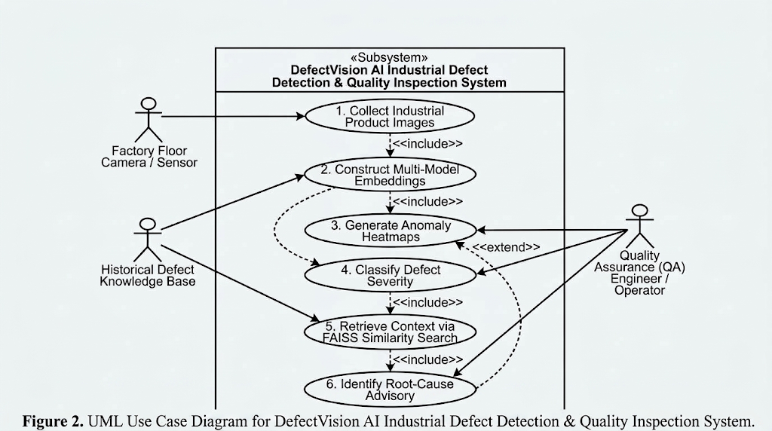
13.1. Use Case Diagram

Slide 26
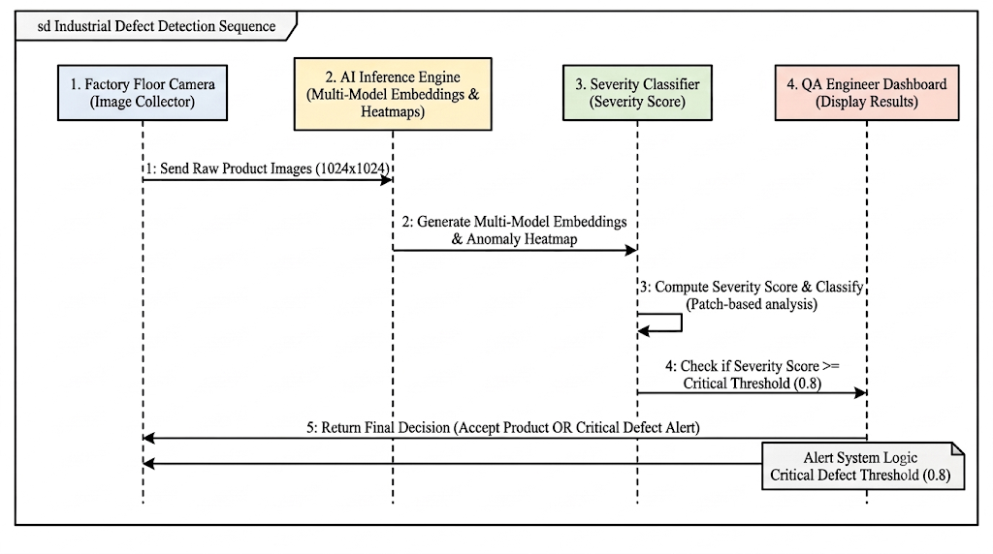
13.2. Sequence Diagram

Slide 27
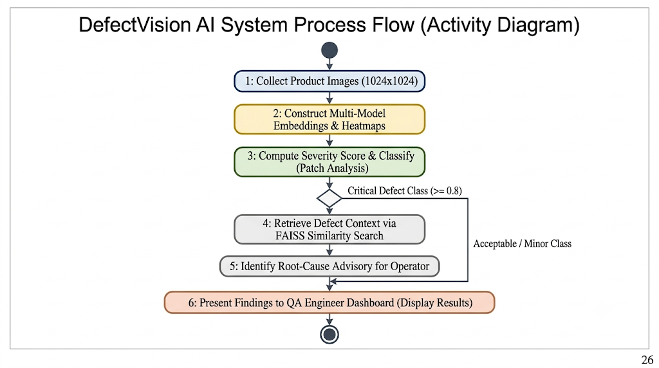
13.3. Activity Diagram

Slide 28
14. Functional Requirements
Table 2: Functional and Non-Functional Requirements of the Proposed System
Req. ID | Requirement Type | System Requirement Specification | Target Metric / Validation Criteria
FR-01 | Functional | Ingest and preprocess industrial inspection images across 15 categories (MVTec AD). Standardize resolution to 1024×1024 → 224×224 tensors | Consistent input dimensions and preprocessing pipeline
FR-02 | Functional | Perform binary classification: Normal vs Defective products | ResNet-50 / EfficientNet-B4; Precision, Recall, F1-score
FR-03 | Functional | Unsupervised anomaly detection with feature extraction, coreset reduction, and patch localization | PatchCore memory bank; Pixel-level AUROC, PRO metric
FR-04 | Functional | Generate visual explanations and compute anomaly severity index | Grad-CAM heatmaps; Severity classes: Minor, Moderate, Critical
FR-05 | Functional | Defect similarity retrieval and RAG-based root-cause advisory | FAISS search (sub-ms latency); Operator remediation logs

Slide 29
14. Functional Requirements
Table 2: Functional and Non-Functional Requirements of the Proposed System
Req. ID | Requirement Type | System Requirement Specification | Target Metric / Validation Criteria
NFR-01 | Non-Functional | Detection sensitivity and zero-shot anomaly localization accuracy | ≥ 99.0% Image-level AUROC, ≥ 97.5% Pixel-level AUROC on MVTec AD
NFR-02 | Non-Functional | Real-time optical inspection inference throughput for factory assembly lines | End-to-end pipeline latency < 35 ms per image frame
NFR-03 | Non-Functional | Memory efficiency for deep feature representations and patch embeddings | Greedy coreset subsampling reducing memory footprint by ≥ 90%
NFR-04 | Non-Functional | Platform scalability, modularity, and drift resilience against image perturbations | Robust to blur, noise, brightness shifts, and production distribution drift

Slide 30
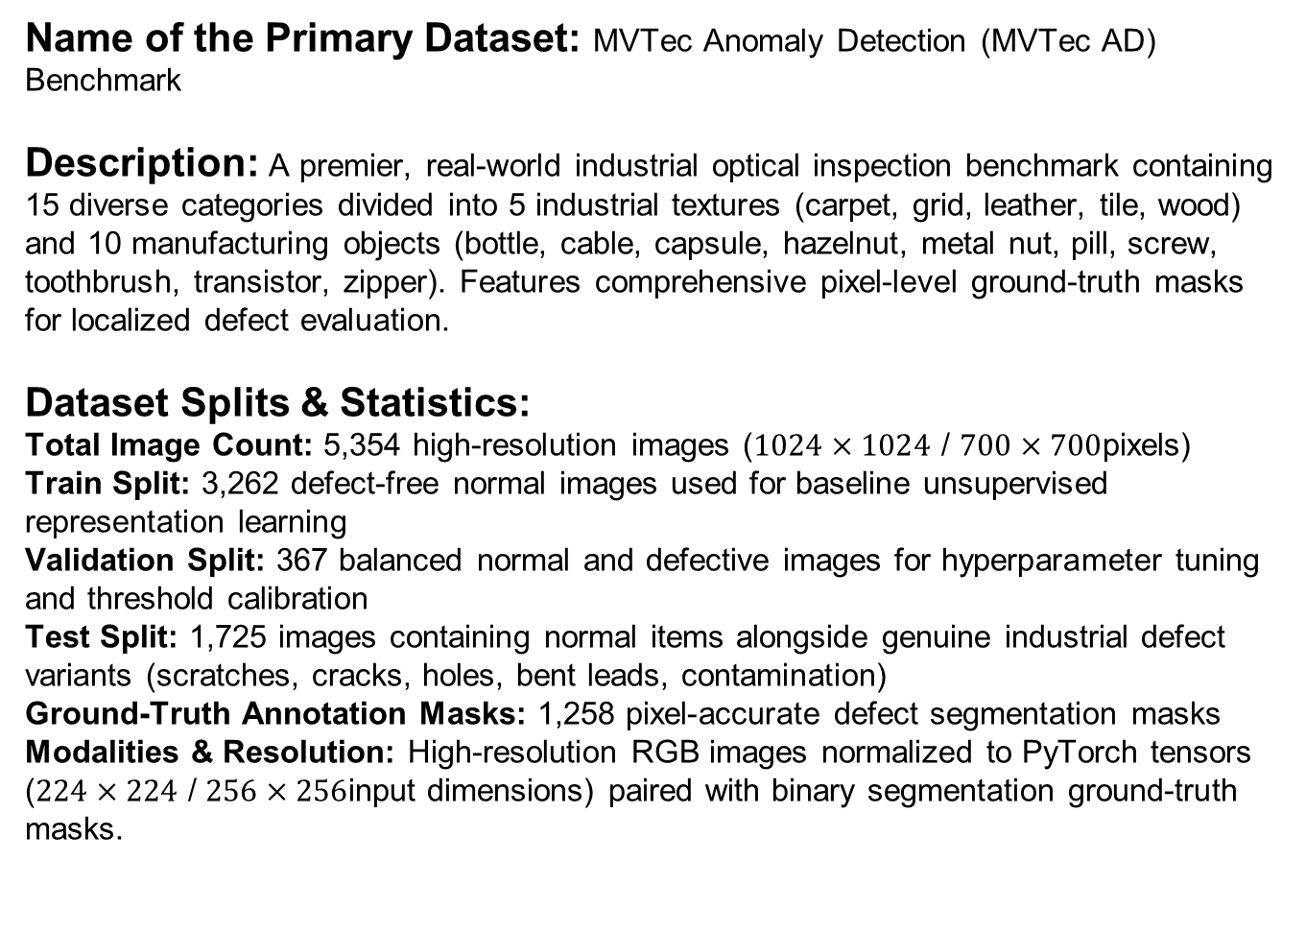
15. Data Collection
Name of the Primary Dataset: MVTec Anomaly Detection (MVTec AD) Benchmark
Description: A premier, real-world industrial optical inspection benchmark containing 15 diverse categories divided into 5 industrial textures (carpet, grid, leather, tile, wood) and 10 manufacturing objects (bottle, cable, capsule, hazelnut, metal nut, pill, screw, toothbrush, transistor, zipper). Features comprehensive pixel-level ground-truth masks for localized defect evaluation.
Dataset Splits & Statistics:
Total Image Count: 5,354 high-resolution images ($1024×1024$ / $700×700$pixels)
Train Split: 3,262 defect-free normal images used for baseline unsupervised representation learning
Validation Split: 367 balanced normal and defective images for hyperparameter tuning and threshold calibration
Test Split: 1,725 images containing normal items alongside genuine industrial defect variants (scratches, cracks, holes, bent leads, contamination)
Ground-Truth Annotation Masks: 1,258 pixel-accurate defect segmentation masks
Modalities & Resolution: High-resolution RGB images normalized to PyTorch tensors ($224×224$ / $256×256$input dimensions) paired with binary segmentation ground-truth masks.

Slide 31
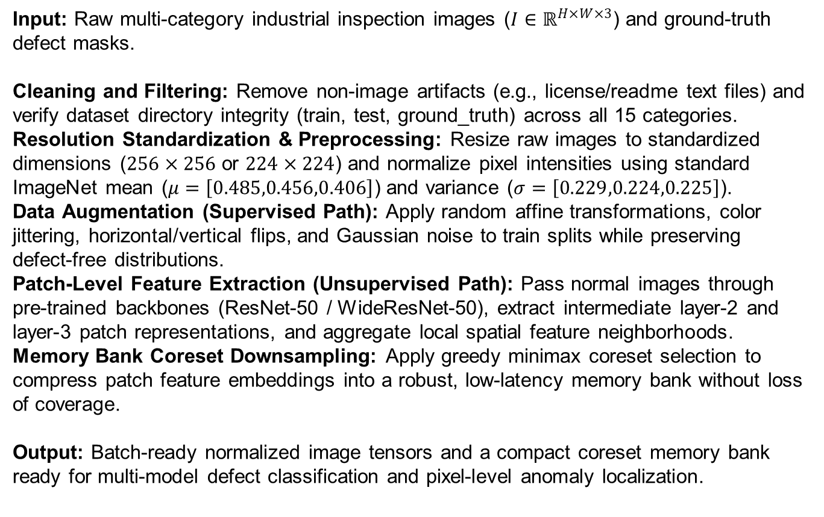
16. Data Preparation
Input: Raw multi-category industrial inspection images ($I∈ℝ^{H×W×3}$) and ground-truth defect masks.
Cleaning and Filtering: Remove non-image artifacts (e.g., license/readme text files) and verify dataset directory integrity (train, test, ground_truth) across all 15 categories.
Resolution Standardization & Preprocessing: Resize raw images to standardized dimensions ($256×256$ or $224×224$) and normalize pixel intensities using standard ImageNet mean ($μ=\left[0.485,0.456,0.406\right]$) and variance ($σ=\left[0.229,0.224,0.225\right]$).
Data Augmentation (Supervised Path): Apply random affine transformations, color jittering, horizontal/vertical flips, and Gaussian noise to train splits while preserving defect-free distributions.
Patch-Level Feature Extraction (Unsupervised Path): Pass normal images through pre-trained backbones (ResNet-50 / WideResNet-50), extract intermediate layer-2 and layer-3 patch representations, and aggregate local spatial feature neighborhoods.
Memory Bank Coreset Downsampling: Apply greedy minimax coreset selection to compress patch feature embeddings into a robust, low-latency memory bank without loss of coverage.
Output: Batch-ready normalized image tensors and a compact coreset memory bank ready for multi-model defect classification and pixel-level anomaly localization.

Slide 32
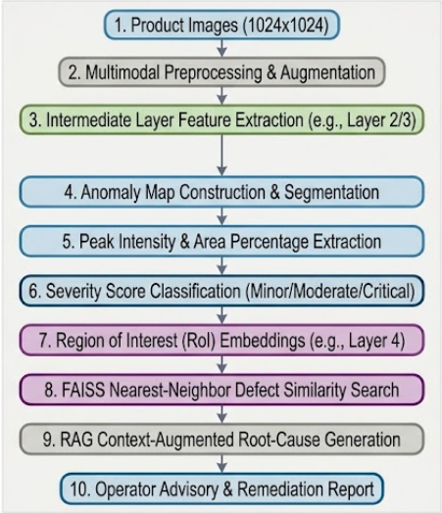
17.1. Proposed System Architecture
Figure 6. Overall System Architecture of the Proposed Multi-Model Industrial Defect Detection and Intelligent Quality Inspection System.

Slide 33
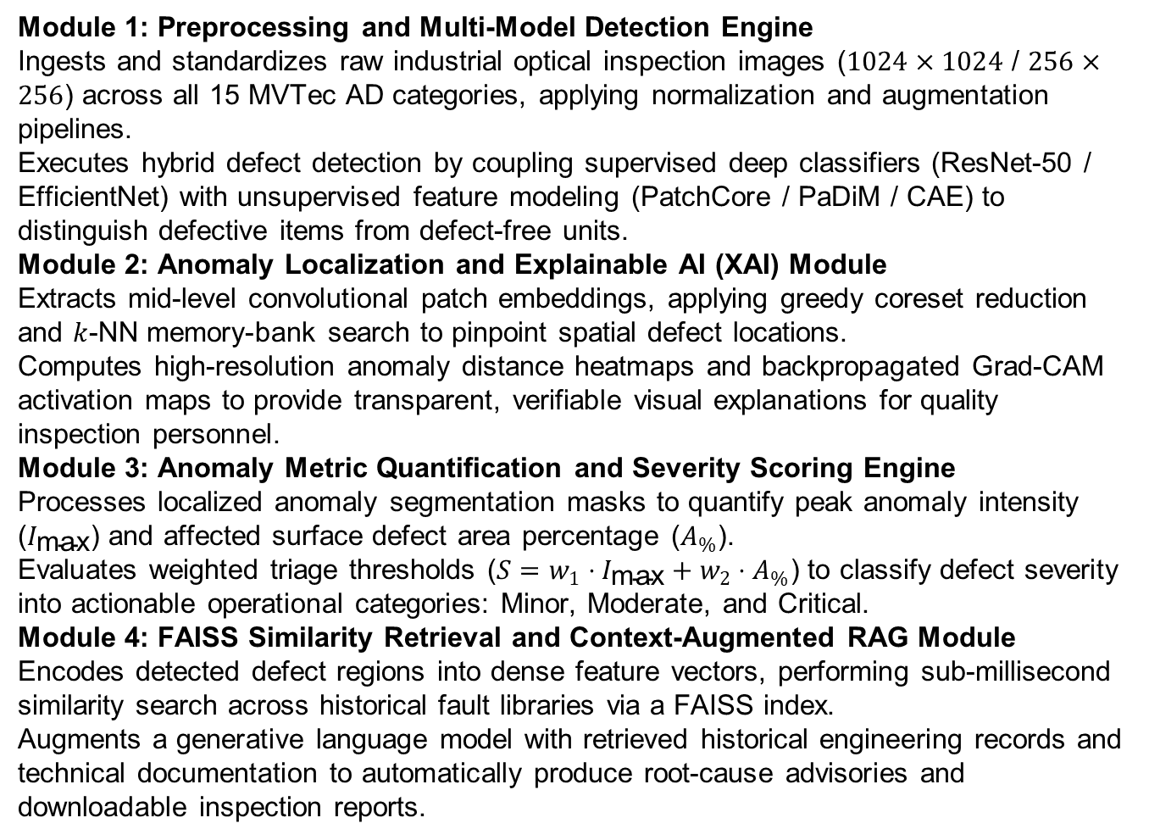
17.2. Different Modules
Module 1: Preprocessing and Multi-Model Detection Engine
Ingests and standardizes raw industrial optical inspection images ($1024×1024$ / $256×256$) across all 15 MVTec AD categories, applying normalization and augmentation pipelines.
Executes hybrid defect detection by coupling supervised deep classifiers (ResNet-50 / EfficientNet) with unsupervised feature modeling (PatchCore / PaDiM / CAE) to distinguish defective items from defect-free units.
Module 2: Anomaly Localization and Explainable AI (XAI) Module
Extracts mid-level convolutional patch embeddings, applying greedy coreset reduction and $k$-NN memory-bank search to pinpoint spatial defect locations.
Computes high-resolution anomaly distance heatmaps and backpropagated Grad-CAM activation maps to provide transparent, verifiable visual explanations for quality inspection personnel.
Module 3: Anomaly Metric Quantification and Severity Scoring Engine
Processes localized anomaly segmentation masks to quantify peak anomaly intensity ($I_{\text{max}}$) and affected surface defect area percentage ($A_{\%}$).
Evaluates weighted triage thresholds ($S=w_{1}⋅I_{\text{max}}+w_{2}⋅A_{\%}$) to classify defect severity into actionable operational categories: Minor, Moderate, and Critical.
Module 4: FAISS Similarity Retrieval and Context-Augmented RAG Module
Encodes detected defect regions into dense feature vectors, performing sub-millisecond similarity search across historical fault libraries via a FAISS index.
Augments a generative language model with retrieved historical engineering records and technical documentation to automatically produce root-cause advisories and downloadable inspection reports.

Slide 34
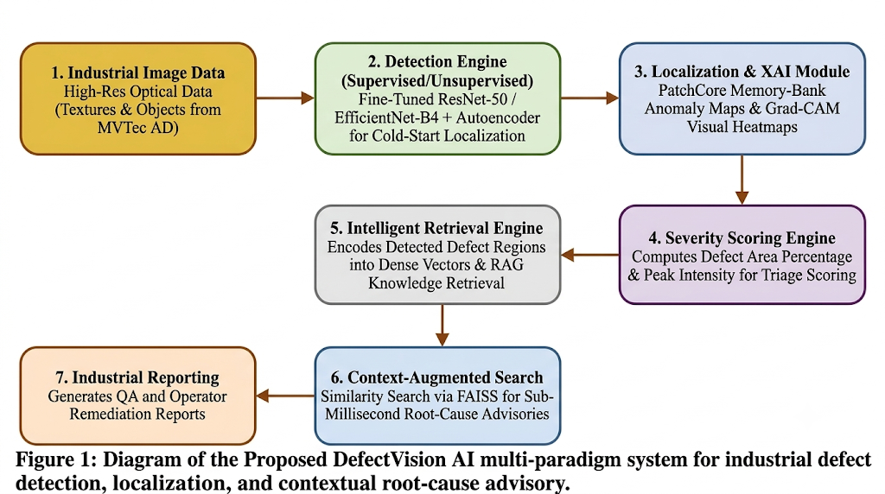
17.3. Proposed Model
Figure 7. Structure of the Proposed Multi-Model Industrial Defect Detection and Quality Inspection System.

